Slide 1





SMART INDIA HACKATHON 2026
" Intelligent Monitoring and Prediction of Conveyor Belt Joint Rupture and Damages in Iron Ore Mining Industry."
  Problem Statement ID –SIH26008
  Problem Statement Title-
"Intelligent Monitoring and Prediction of Conveyor
Belt Joint Rupture and Damages in Iron Ore Mining
  Industry."
  Theme-Smart Automation
  PS Category- Hardware
  Team ID-SIH26-A0H-T276
  Team Name (Registered on portal)-HexaCore
1

Slide 2



CONVEYOR HEALTH MONITORING
Detailed Solution
To detect any abnormalities like more friction between conveyor belt and the rollers below, belt misaignment, and any jamming in the conveyor joint, power and torque delivered is measured.
Cameras are used to detect damage to belt.A camera with a top view from above and one from below. And two cameras on either side.
What makes us different
Our system creates a normal motor-load signature for varying ore loads and detects unexpected increases in power/torque/current while maintaining constant belt speed.
So even if the ore load changes unpredictably, the system doesn't need to know the exact mass.
It asks:
“Given the current operating conditions, is the motor working harder than it normally should?”
If yes → early anomaly alert → targeted inspection.
To find locations more precisely:
  We place vibration sensors at consecutive locations to detect the problematic location more precisely.
Industrial IO module digitizes sensor signals and streams them in real time - no manual logging, no data gaps
→
→
To calculate motors power:
The motors Torque is:
The footage is then processed and any damage to conveyor belt is detected. If any, damage is evaluated and sent to dashboard.Thinning of belt is also measured.
→
AI runs on-site, fuses vision + sensor data into one explainable risk %, instantly - no cloud wait time
→
Logs yield,
works offline
→
→
→
Since there will be variations in toque and power according to the amount of the ore material on the belt, both parameters are measured in real time. So abnormalities will be identified instantaneously. Here belt speed would be constant.
The camera below the belt can detect any damage to the belt with a hindrance from iron ore material.Cameras from side will measure thickness of belt.
Risk score reaches the operator's existing HMI screen; PLC still makes the final safety call — no new system to learn
→
To ensure safety of the conveyor joint temparature is also measured besides
power.
→
→
Siren fires directly on high risk, fully independent of network — alert always gets through.
Torque allows to replace the mass of ore qualitatively in the equation so that the belt speed remains constant
Can be used with LED/industrial lighting to maintain consistent image quality even in low-light mining environments.
The sensor will measure temperature if the delivered power exceeds a threshold value.
An alarm will be raise
Notes:
2

Slide 3
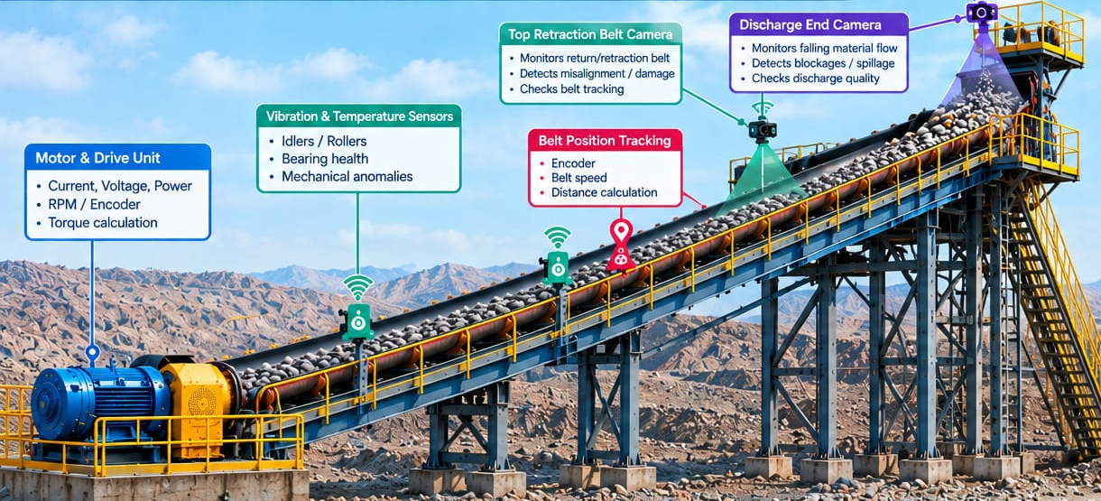
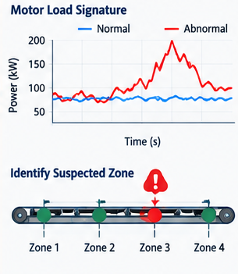
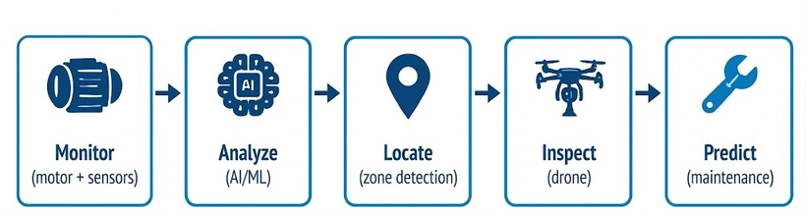
TECHNICAL APPROACH
  Sensors on the belt feel things — vibration, heat, misalignment.
  IoT digitises the data, and tramsmits it
  Those numbers go to a local mini-computer at the mine site.
  That mini-computer runs the AI right there and figures out: "is this joint in danger?"
  If yes, it sends that warning to the PLC (the machine that controls the belt) and the SCADA screen (the operator's usual screen) .
  If it's really serious, a siren/light goes off on-site too, as backup.
  Everything gets saved locally.
1.Industrial RGB camera: Basler ace 2 Basic
(a2A2448-23gcPRO) , pixels (2448 × 2048 / 5MP)
2.edge AI - YOLO + open CV
3. Constant speed control PLC+VFD
4.Real time monitoring
5.Torque Based Analysis: Expected vs Actual Torque
6.Fault Detection
7.Mass independent AI: The system does not require
direct mass measurement .
8.Predictive Maintenance: Generates early warning and trigger targeted RGB + thermal inspection for
fault confirmation
3
Notes:
3

Slide 4
FEASIBILITY AND VIABILITY
ECONOMIC
TECHNICAL
SOCIAL
  Supports faster emergency response through real-time alerts.
  Creates opportunities for skilled technical jobs in AI and automation.
  Reduces worker exposure to dangerous conveyor-belt inspection and maintenance.
  Early-warning alerts let operators act before a rupture becomes serious.
  Helps prevent production interruptions.
  Locate the affected zone precisely.
  Less unplanned downtime – improves the reliability of critical material-transport infrastructure.
  Reduces downtime caused by unexpected belt and motor failures.
  Cuts maintenance costs through early fault detection.
  Prevents production losses by enabling timely maintenance
  Uses existing PLC/VFD systems, reducing installation costs.
  Improves return on investment (ROI) through continuous monitoring.
  Extends component life, reducing frequent replacement costs.
  The system can be integrated with existing PLC/VFD infrastructure, making it relatively low-cost and scalable across multiple conveyor sections.
  The initial investment can be recovered through reduced downtime and preventive maintenance costs.
•Constant-speed operation — VFD + speed feedback maintains the conveyor at a fixed belt speed despite continuously varying ore load.
• Real-time load indication — Motor current rises with increasing torque demand; no direct mass measurement is required.
• Fault detection — Persistent deviation between predicted and measured power/torque indicates abnormal friction, roller/bearing failure, belt misalignment or possible splice damage.
•Torque-Based Load Monitoring
Instead of directly measuring ore mass, estimate the required motor torque.
Mechanical power: Pₘₑcₕ = T × ω
At approximately constant speed, abnormal increase in required torque can indicate additional resistance.
4
Notes:
4

Slide 5
IMPACT AND BENEFITS
IMPACT FLOW
  SENSING
2.IoT Data Acquisition
3.Edge AI & Risk Scoring
4.PLC/SCADA Integration
5.Local Alerting
6.Data Logging & Cloud Sync
Measures Electric load on motor,torque, temperature, alignment (rip/tracking), and load.
Real-time signal digitization and transmission.
On-site, explainable risk score, low latency.
Alerts land directly on existing operator HMI.
Even if the internet totally dies, someone still gets warned.
Local storage now, cloud sync when available.
KEY BENEFITS
  No need to replace existing equipment
  Works without reliable internet
  Mass-Independent Monitoring
  Predictive Fault Detection
Detects abnormal power/torque demand without requiring continuous direct measurement of ore mass.
Identifies abnormal conveyor position before it develops into a major breakdown.
Detects thinning,wear and tear in belt before consequential damage.
Runs fully on-site, so it stays effective even at remote, low-connectivity mine locations.
Integrates directly with whatever PLC/SCADA system the mine already uses.
Prototype success can be demonstrated through: continuous sensing • Edge AI Digitalisation • Control Room Integration • Local & Cloud Sync
5
Notes:
5

Slide 6
RESEARCH AND REFERENCES
  Author(s), Title of paper, Journal/Conference, Year.
  Author(s), Title of paper, IEEE/Elsevier, Year.
  CEMA, Belt Conveyors for Bulk Materials.
  Directorate General of Mines Safety (DGMS), Government of India, relevant mining safety regulations.
  Indian Bureau of Mines, Government of India, mining statistics/reports.
  AI Models-Claude and Gemini
6
Notes:
6

